Slide 1
H-1B Visa Petitions
Aubrey Sharwarko
Regis University
MSDS 692 Summer, 2017

Slide 2
Background
H-1B is an employment visa for temporary, non-immigrant workers in the United States.
A US employer must extend a job offer and initiate the H-1B petition process through the US Immigration Department.
The H-1B is the most common visa applied for and held by international students (Naribole, 2017).
Data was originally collected and made public by The Office of Foreign Labor Certification.

Slide 3
H-1B Visa Petition Dataset
3 Million Total Records
Data Collected between 2011 -2016
10 Features Collected
Majority categorical
Notes:
Data retrieved from: https://www.kaggle.com/nsharan/h-1b-visa

Slide 4
Feature Descriptions
Field Name | Description
CASE_STATUS | The final status of the petition after LCA processing. Note – “Certified” means the applicant is eligible to file an H-1B, not that they have received an H-1B.
EMPLOYER_NAME | Name of the company/business sponsoring the H-1B petition.
SOC_NAME | Name of occupation, as classified by the Standard Occupational Classification(SOS) System.
JOB_TITLE | Title of job which will be filled by perspective applicant.
FULL_TIME_POSITION | “Y” or “N” value indicating whether the petition is for full tie employment.
PREVAILING_WAGE | Annual salary(in USD) for the job that is to be filled.
YEAR | The year the H-1B petition was filed.
WORKSITE | City and state where the worker will be employed
lon | Longitude of the sponsor worksite
lat | Latitude of the sponsor worksite.

Slide 5
Data Sample
10 Features

Slide 6
Project Goals
Predict Petition Outcome
Model Association Rules
SVM
Decision Trees
Use Apriori algorithm to model association rules present in the Kaggle dataset.

Slide 7
Data Preprocessing and EDA Findings

Slide 8
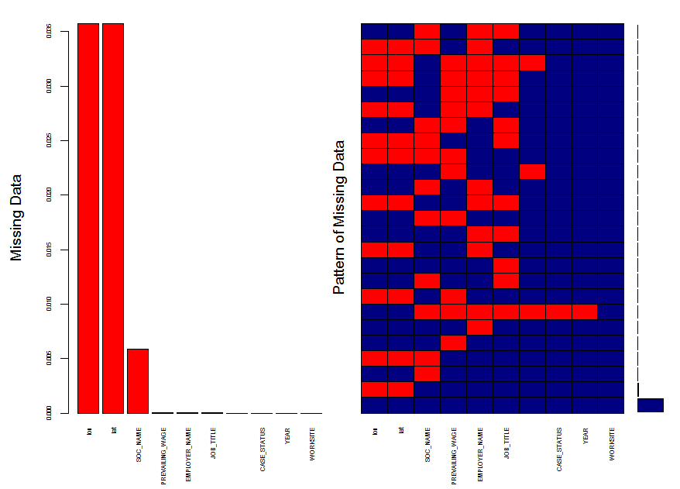
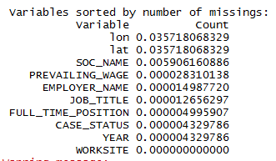
Visualizing Missing Data Fields
Using VIM and mice R Libraries
Notes:
Conclusion: I decided to omit, rather than impute rows with missing values. Omitting NULL values reduced the original dataset from 3,002,458objects down to 2,877,783.

Slide 9
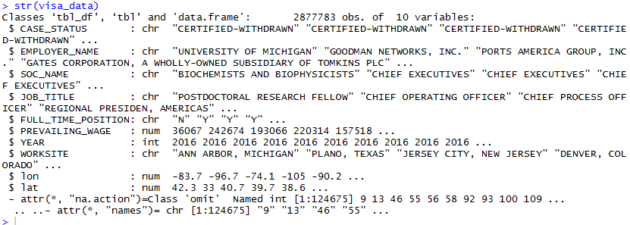
Breakdown of Data Types
Notes:
Majority of data fields are categorical. I can also see that some of the features seem to be redundant, and not helpful to the models I hope to build. Example: lon and lat values will likely confirm the value in the WORKSITE field.

Slide 10
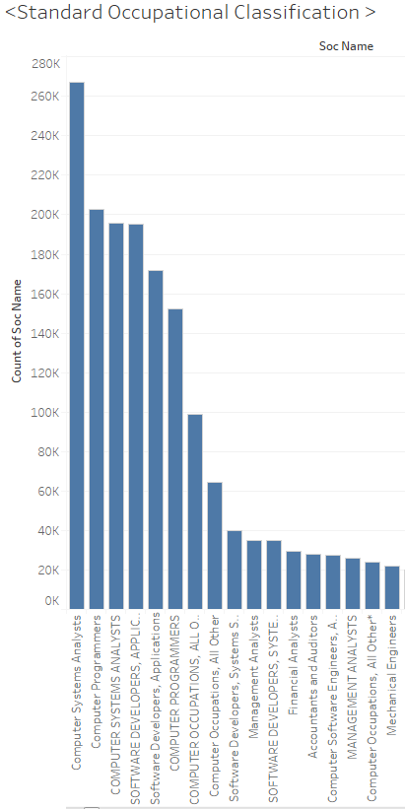
Data Quality Issues from Naming Conventions
Notes:
Categories need to be joined, as the naming conventions changed (See “computer programmers” versus “COMPUTER PROGRAMMERS”)

Slide 11
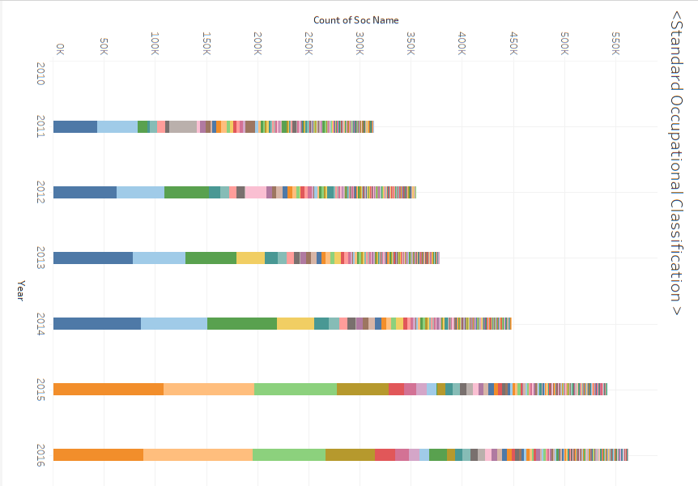
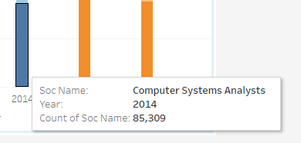
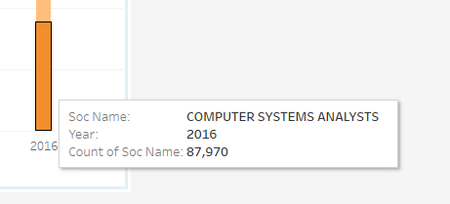
Change in Naming Convention after 2014
Notes:
Unfortunately, the data set changes after 2014 due to the use of capital letters or other additions.

Slide 12
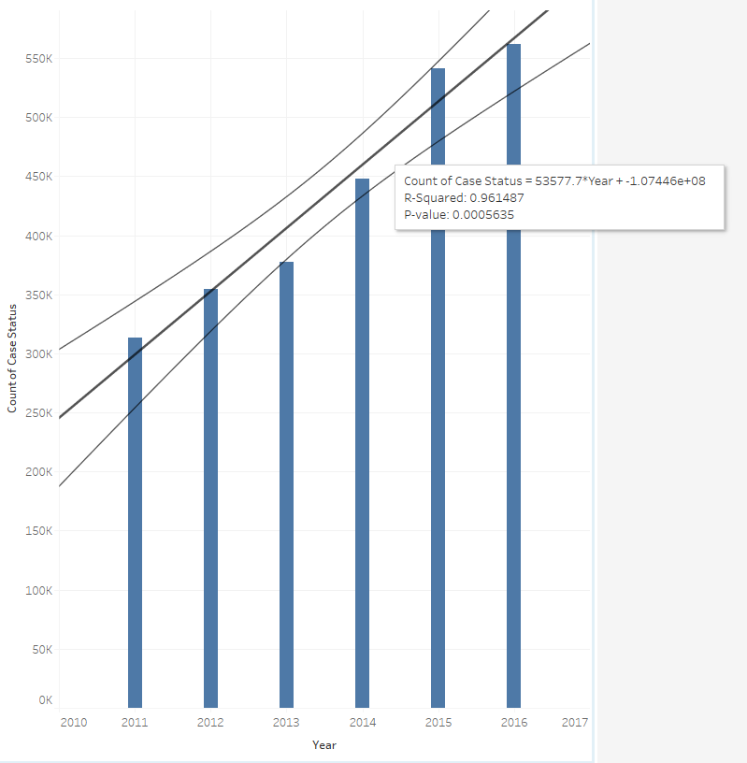
Case Entry Growth Rate
Notes:
The growth rate of applicants conforms well to a linear model.

Slide 13
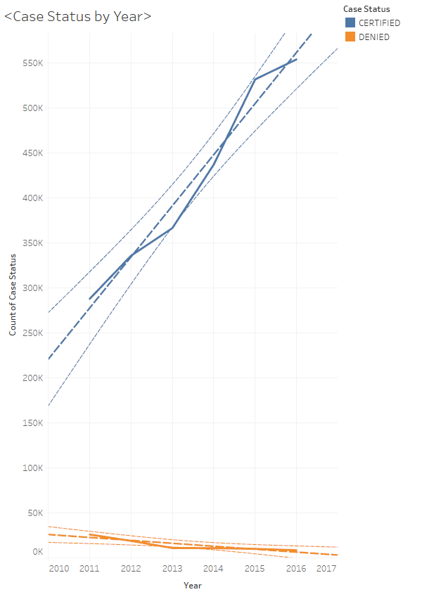
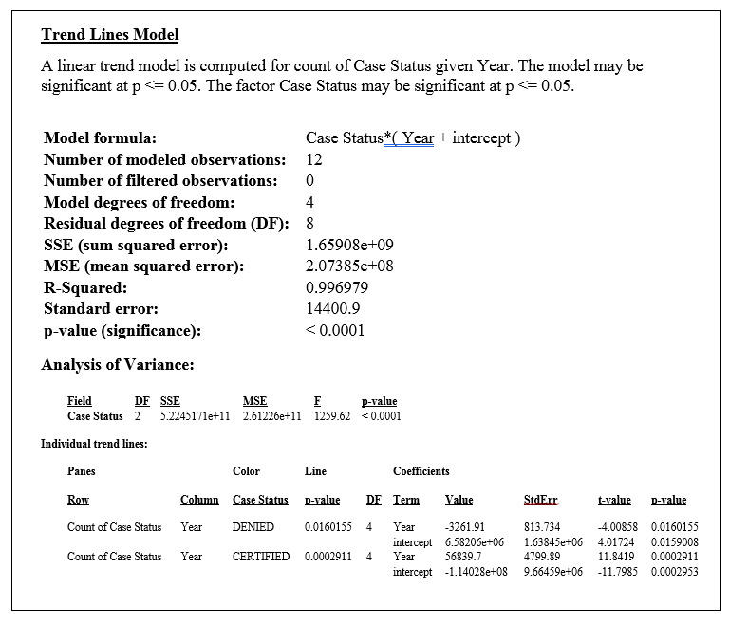
Case Status by Year
Notes:
The trend of both the denied and certified cases conform well to linear models

Slide 14
Projection for Certified and Denied
Notes:
Using a linear model, here is the projection for each case status to 2020. The denied status shrink to zero after 2018 if the trend continues.

Slide 15
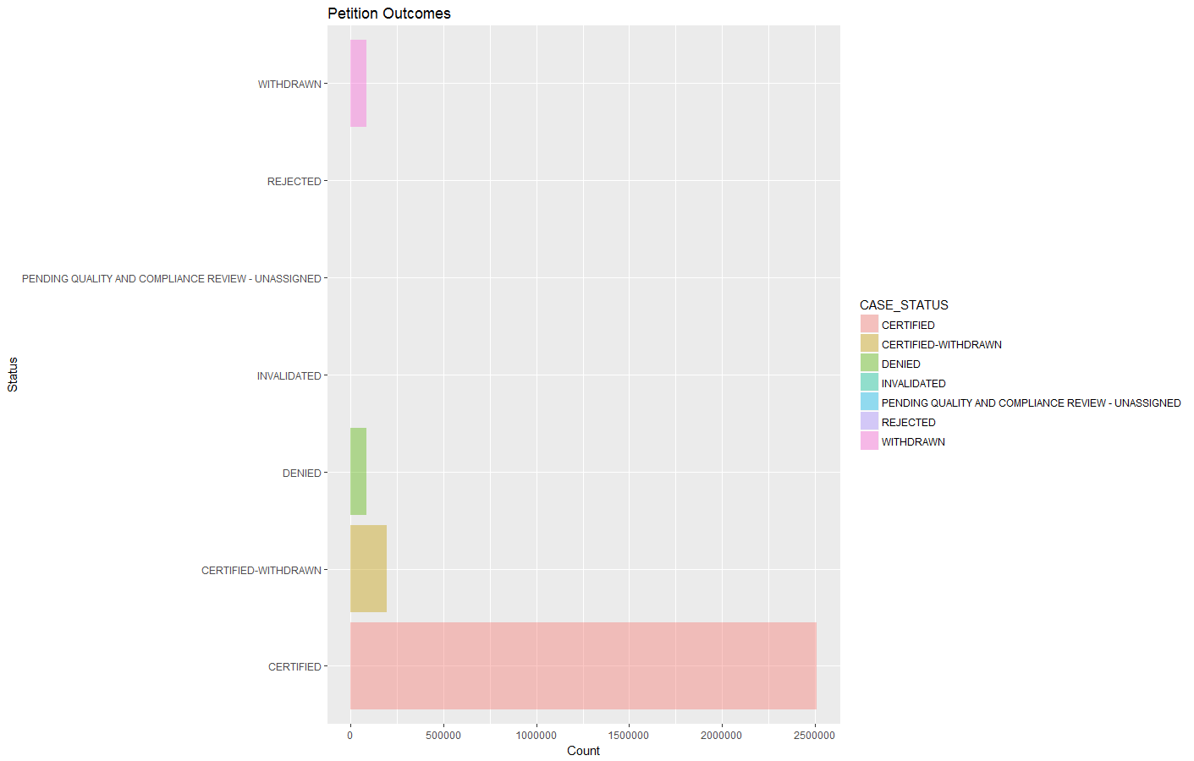
Petition Status
Notes:
Surprising results: The data description from Kaggle lists CASE_STATUS as having values of “Certified,” “Certified-Withdrawn,” Denied,” and “Withdrawn”. The data set contains 7 possible values rather than 4. The “Certified” response is dominating this data set.

Slide 16
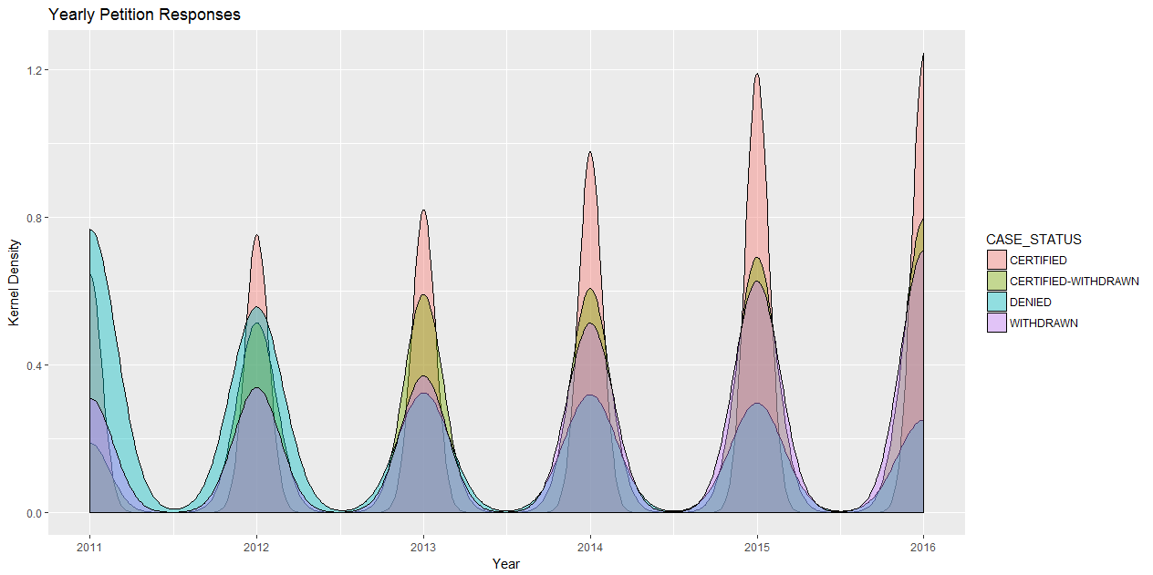
Kernel Density Plot: Case Status by Year

Slide 17
Predicting Petition Outcome

Slide 18
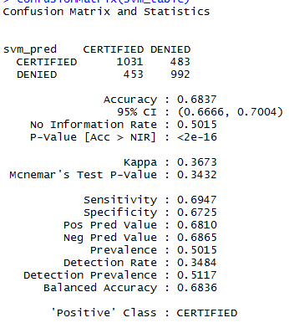

SVM – Radial Kernel

Slide 19
H-1B Association Rules

Slide 20
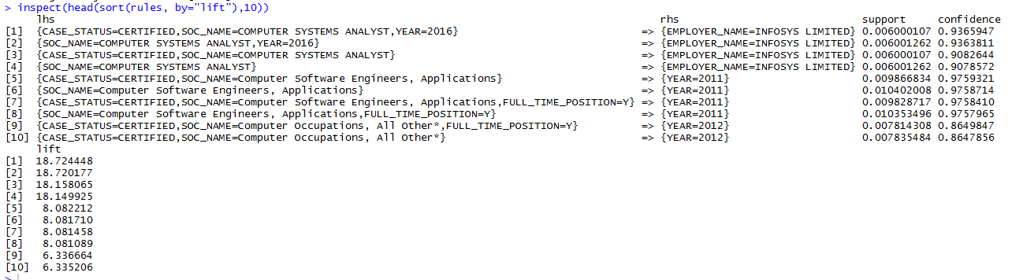
Top 10 Rules by Lift
Notes:
The top 4 rules have very high lift scores of > 18.

Slide 21
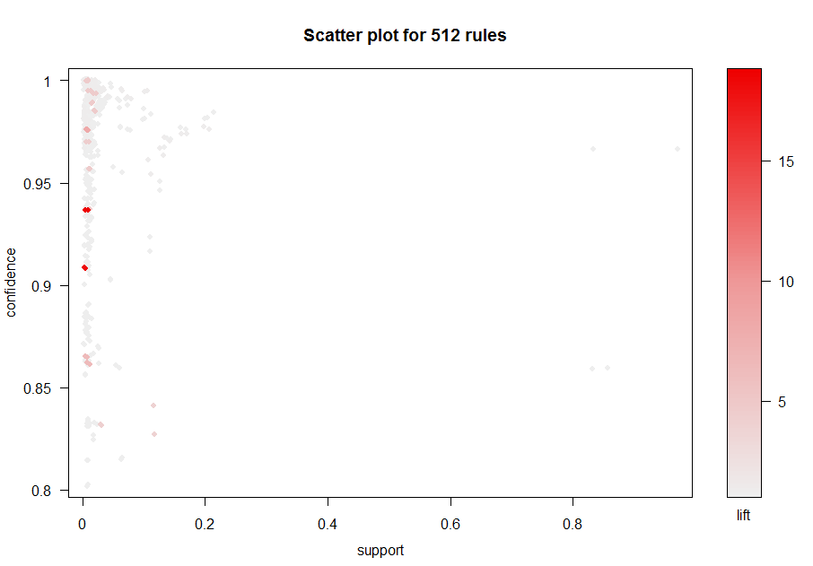

Slide 22
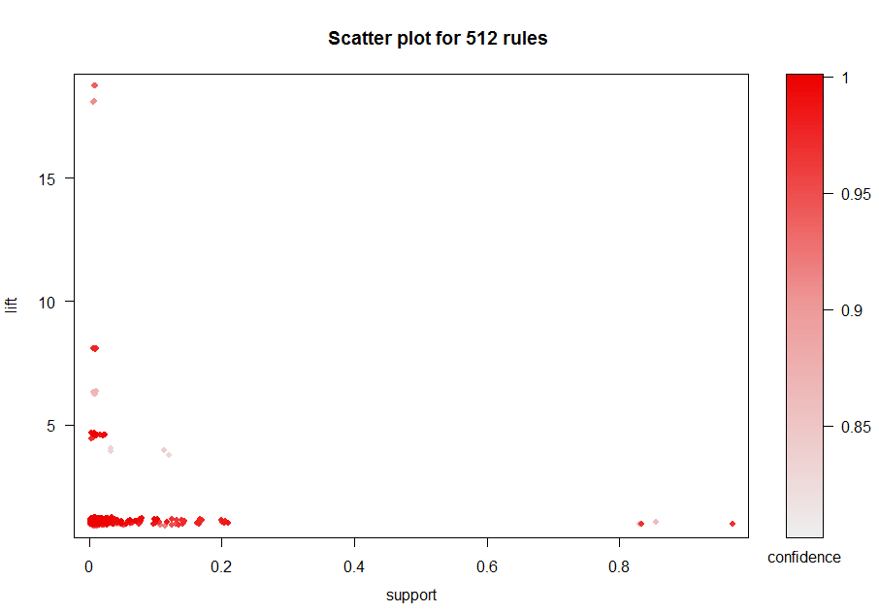

Slide 23
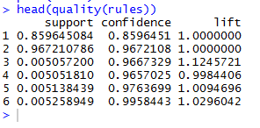
Notes:
Li

Slide 24
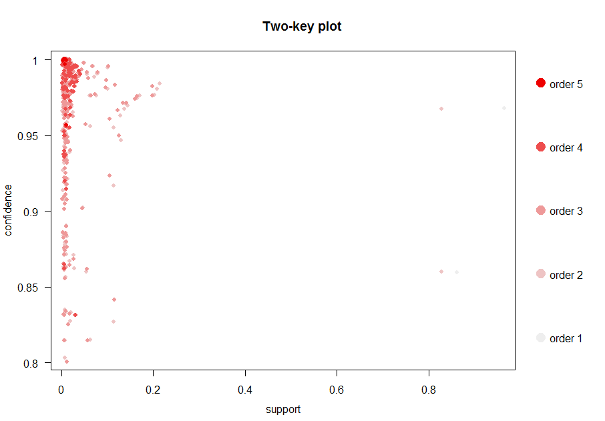

Slide 25
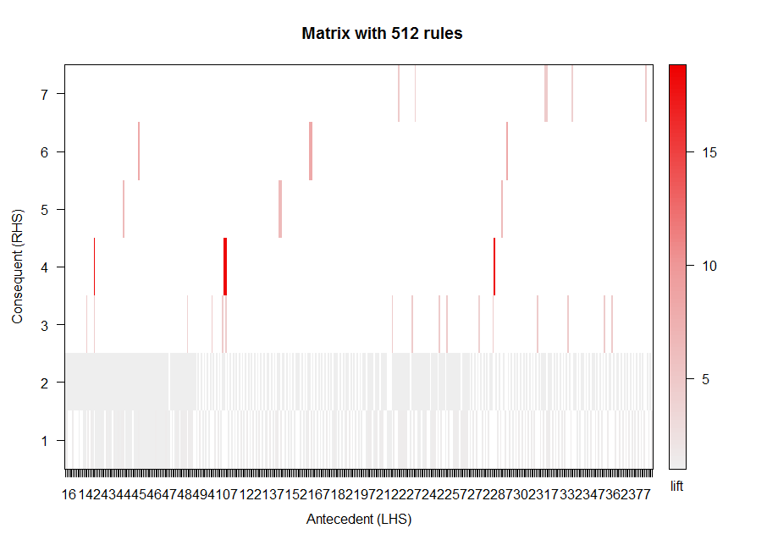

Slide 26
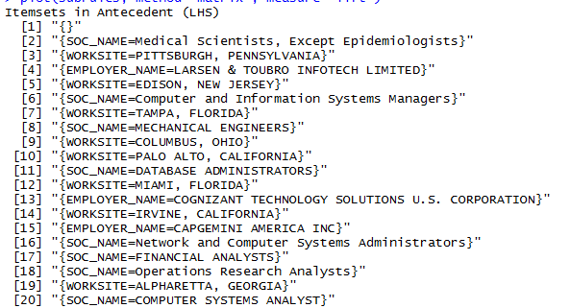
Top 20 Subrules

Slide 27
Conclusions/Wrap-Up

Slide 28
Findings
The association rules were successful, and many of the rules scored high on lift and confidence. Unfortunately, the small feature size and the high variance of job labels made the rules somewhat convoluted.
The classification model accuracy is very low. I attribute this to the inconsistent job labels, and lack of more diverse features.
The projected trend for H-1B petition volume should increase, as it has steadily over the last 6 years.
More data is needed to understand why the “Denied” case status has decreased so drastically over the years. This may be due to a change in US policy, but there was no signal present in the data to indicate

Slide 29
Challenges
The data set, as provided by the Kaggle competition, is lacking the features need to derive some of the insights I had hoped to glean. The original dataset that is amassed by the U.S. Department of Labor contains 40 data fields, and many of those fields would be useful in trying to better understand why a H-1B visa petition would be certified or denied.
Inconsistent naming conventions for job titles and SOC Names detrimentally affected the performance of my classification models
The size of the dataset was challenging to work with in my native environment.
Notes:
Link to U.S. Department of Labor data field descriptions: https://www.foreignlaborcert.doleta.gov/docs/Performance_Data/Disclosure/FY15-FY16/H-1B_FY16_Record_Layout.pdf

Slide 30
Next Steps
Consolidate job title variables
Investigate obtaining data directly from the US Department of Labor, and bypass the dataset provided by Kaggle
Sign up to use the Regis University Lab machine! Trying to wrangle with 3 million records on 8gm of ram is tedious, slow, and inefficient.

Slide 31
References
Naribole, S. (2017). H-1B Visa Petitions 2011-2016. Retrieved from: https://www.kaggle.com/nsharan/h-1b-visa
Chiu, Y. (2016). R for Data Science Cookbook. Packt Publishing. Retrieved form: http://proquest.safaribooksonline.com.dml.regis.edu/book/programming/r/9781784390815
US Department of Labor. (2017). OFLC Performance Data. Retrieved from: https://www.foreignlaborcert.doleta.gov/performancedata.cfm
US Department of Labor. (2017). H-1B iCert LCA. Retrieved from: https://www.foreignlaborcert.doleta.gov/docs/Performance_Data/Disclosure/FY15-FY16/H-1B_FY16_Record_Layout.pdf

